Slide 1
Introducing A completely natural and highly effective skin care line…

Slide 2
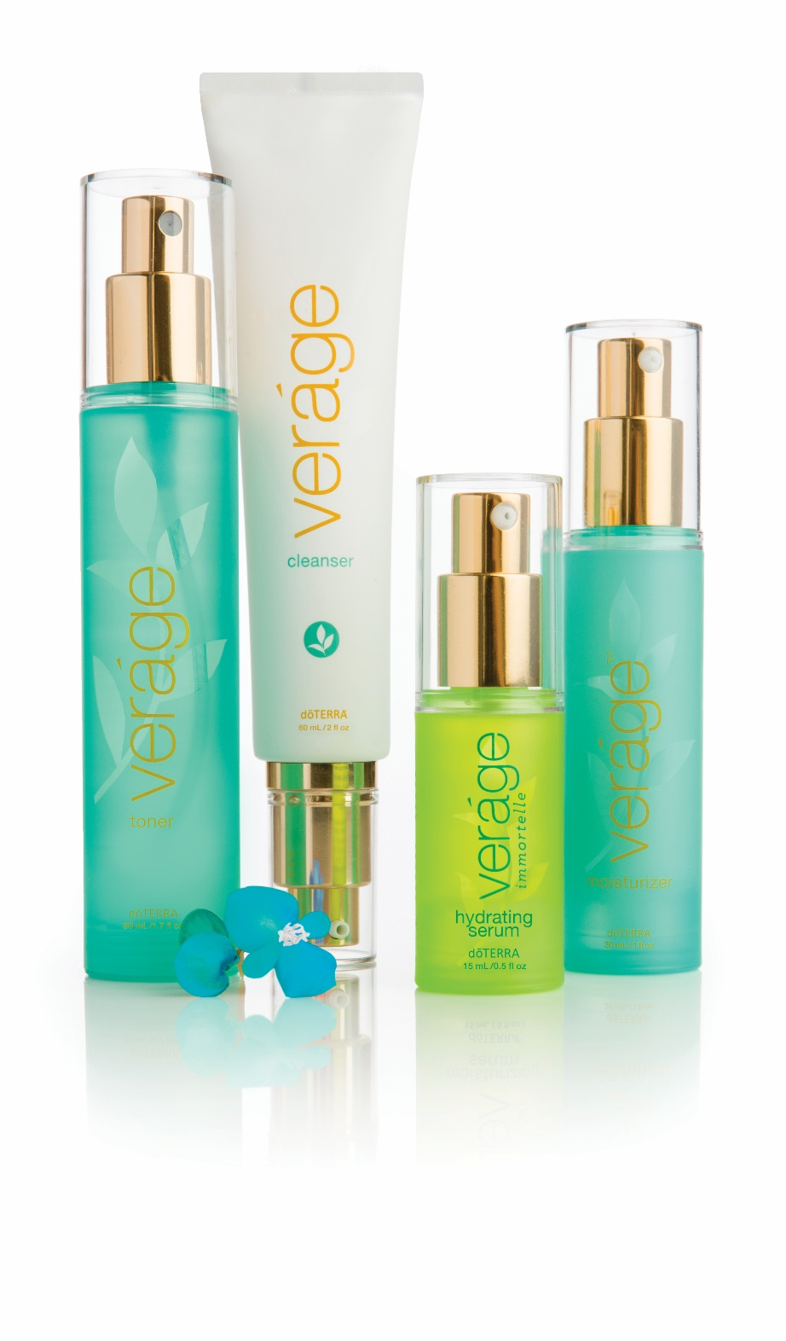
Vérage™ ^{(True Earth)}

Slide 3
Vérage™
CPTG® Essential Oils
Scientifically proven plant extracts
Natural preservative system
Highly effective formulas
Amazing results

Slide 4
Vérage™ ^{Cleanser}
Gel cleanser
Lifts away dirt, makeup, and impurities
Reaches deep into pores to cleanse and purify
Nourishes and protects the skin’s appearance
Hydrates skin and reduces trans-epidermal
water loss
Refreshing, herbaceous aroma

Slide 5
Vérage™ ^{Cleanser}
Wild Orange, Melaleuca, Basil cleanse and purify
Macromolecule combination
Coconut oil is a natural surfactant and boosts the effectiveness of other surfactants
Olive oil (fatty acid) reduces trans-epidermal water loss
Fructose softens and moisturizes skin

Slide 6
Vérage™ ^{Toner}
Tightens, tones, and smoothes skin
Reduces the appearance of pores
Convenient pump allows you to tone and freshen
skin anytime, anywhere
Refreshing and cooling mist
Copper mineral provides light blue tint
Clean, fresh scent

Slide 7
Vérage™ ^{Toner}
Coriander and Cypress tone and rejuvenate skin
Palmarosa helps to reduce the appearance of oily skin
Ylang Ylang soothes, nourishes, and protects skin
Witch hazel and aloe provide many benefits to the skin
Malachite copper mineral provides antioxidants and promotes skin elasticity (gives toner blue tint)

Slide 8
Vérage™ ^{Immortelle Hydrating Serum}
Contains Immortelle Essential Oil Blend
L22® is a combination of jojoba, macadamia and olive esters which mimic the skin’s surface lipids when at optimum health and youth (typically 22 years)
Provides a youthful-looking, glowing complexion
Improves skin’s appearance
Hydrates skin significantly better than common emollients
http://www.lipids22.com/

Slide 9
Vérage™ ^{Moisturizer}
Provides deep hydration and skin nourishment
Reduces the visible signs of aging
Promotes an ideal moisture balance in skin
Light, non-greasy moisturizer
Absorbs quickly but hydrates deeply

Slide 10
Vérage™ ^{Moisturizer}
Sea Buckthorn Berry provides a rich supply of Omega 7 fatty acids that nourish, soften and protect skin and help it retain moisture
Juniper Berry helps to reduce the appearance of aging skin
Rice bran oil and shea butter contain fatty acids that penetrate deeply into the skin to moisturize, plump, and nourish skin
Phellodendron Amurense (Cork Tree) Bark helps to calm and soothe skin
Contains Jasmine, Geranium, and Sandalwood essential oils

Slide 11
Vérage™ ^{Preservative System}
Potassium sorbate is a potassium salt of sorbic acid, a naturally occurring preserving compound
Sodium benzoate is the sodium salt of benzoic acid and occurs naturally at low levels in cranberries, prunes, plums, cinnamon, ripe cloves, and apples.
Benzyl alcohol is produced naturally by many plants and is commonly found in fruits and teas. It is also found in a variety of essential oils including jasmine, hyacinth, and ylang-ylang.

